Slide 1


On the Joint Control of Multiple Building Systems with Reinforcement Learning
Tianyu Zhang¹, Gaby Baasch², Omid Ardakanian¹, Ralph Evins²
February 2021
¹
²
Notes:
Hello everyone. I’m Tianyu Zhang from the University of Alberta. Today I present a study called on the joint control of multiple building systems with reinforcement learning. This is joint work with my supervisor Omid Ardakanian, and Gaby and Ralph from the University of Victoria.

Slide 2




Motivation
Commercial sector used 12.3% energy (9.3 quads) in the United States in 2019, with 40.6% used for HVAC and lighting.
Energy Consumption Sectors
US: 12.3%
Notes:
So, let’s start with the motivation of this work. Energy has long been a topic in modern studies because we use energy everywhere, such as the electricity, and petroleum. <click> We can conclude the energy consumption into four sectors, residential sector, commercial sector, industrial sector, and transportation sector. <click> Commercial sector used 12.3% energy in the United States in 2019. <click>

Slide 3





Motivation
In the country with extreme weather, more energy is consumed for HVAC and lighting. Canada used 79.1% energy for HVAC and lighting.
Commercial sector used 12.3% energy (9.3 quads) in the United States in 2019, with 40.6% used for HVAC and lighting.
Lighting
HVAC
US: 40.6%
CA: 79.1%
Notes:
If we break down the commercial buildings’ energy consumption by end use, Heating, Ventilation, and Air Conditioning system, or HVAC system and lighting system together consumes forty-point-six percent energy in US. <click> For even colder or hotter countries, this percentage will become even higher. For example, if we investigate Canada, a country with colder climate, HVAC and lighting system consumes 79.1% of total energy use in commercial buildings. Therefore, we need a solution to reduce the energy used by HVAC and lighting system while maintaining the thermal and visual comfort of the occupants.

Slide 4





Proposed Solution
We jointly control the HVAC system supply air temperature and blind angle setpoints in a 5-zone test building with and without auto dimming control of lights using 3 model-free RL algorithms (BDQN, SAC, PPO) in two seasons with two occupancy information.
RL Agents
Rule-based
Notes:
To achieve this goal, <click> we jointly control the HVAC system supply air temperature and blind angle setpoints using model-free RL agents <click> with and without rule-based auto dimming control of lights in a 5-zone test building <click> in two seasons with two occupancy information.

Slide 5
Proposed Solution
We jointly control the HVAC system supply air temperature and blind angle setpoints in a 5-zone test building with and without auto dimming control of lights using 3 model-free RL algorithms (BDQN, SAC, PPO) in two seasons with two occupancy information.
Our results show that we can save additional 11% energy in winter and 31.8% energy in summer compared to existing rule-based control strategies with zone-level occupancy.
31.8% saving
vs
11.0% saving
RL Agents
Rule-based
Rule-based
Notes:
Our results show that compared to baseline approaches, we can further save <click> 11% in Winter and 31.8% in summer when zone-level occupancy information is available

Slide 6
Outline
Challenges and previous work
RL Problem Formulation
Control Scenarios
Baselines and Agents
Research questions and results
Takeaways and future work
Notes:
Now, in the rest of this talk we will explain the study in detail. We start with the challenges of this work, and the gap in previous works. We then explain the RL problem formulation, control scenarios, baselines and agents. After that we discuss results of our experiments, and finally talk about the main takeaways of this talk and avenues for future work.

Slide 7
Challenges
Energy Consumption
Indoor Temperature
Indoor Brightness
HVAC
Open
Notes:
First, let’s investigate why this work is non-trivial. In this work, <click> three subsystems can be controlled, which are the blinds, HVAC, and lights. The goal of controlling these subsystems is to <click> minimize the energy consumption, while maintaining the indoor temperature and brightness in a comfort range to fulfill the thermal comfort and visual comfort of occupants. But the interactions of these subsystems are complex. For example, <click> if we open the blinds, then the indoor temperature will goes up due to the solar radiation, and the indoor brightness will goes up as well as the natural lights comes in. These effects then makes other building systems to react. For example, in summer season, <click> the HVAC might need to do extra works to balance the solar radiation by cooling down the building. <click> For lighting system, since there are some natural lights, the artificial light can be dimmed to save energy

Slide 8
Challenges
Energy Consumption
Thermal Comfort
Visual
Comfort
HVAC
Notes:
Therefore, it is not easy to optimize both objectives at the same time. This makes the joint control of the building non-trivial.

Slide 9
Previous works
Rule-based and model-based approach mainly focus on one system
Model-free approach mainly focus on one zone only, and never talk about the trade-off for multiple objectives
We focus on a multi-zone building (5 zones), and discuss the three-way trade-off
Lack of study on investigating the impact of different available occupancy information
We test all algorithms with two different occupancy information
The proposed RL algorithm selection criteria are not clear
We pick most representative RL algorithms in each direction of RL
Baselines are too weak
We evaluate multiple baselines and pick the most suitable one as our baseline
Notes:
There are lots of attempts to optimal building systems, but rule-based and model-based approach mainly focus on one system only, such as HVAC only, or lighting system only. This is due to the complexity of optimizing the joint control we just discussed previously.

Slide 10
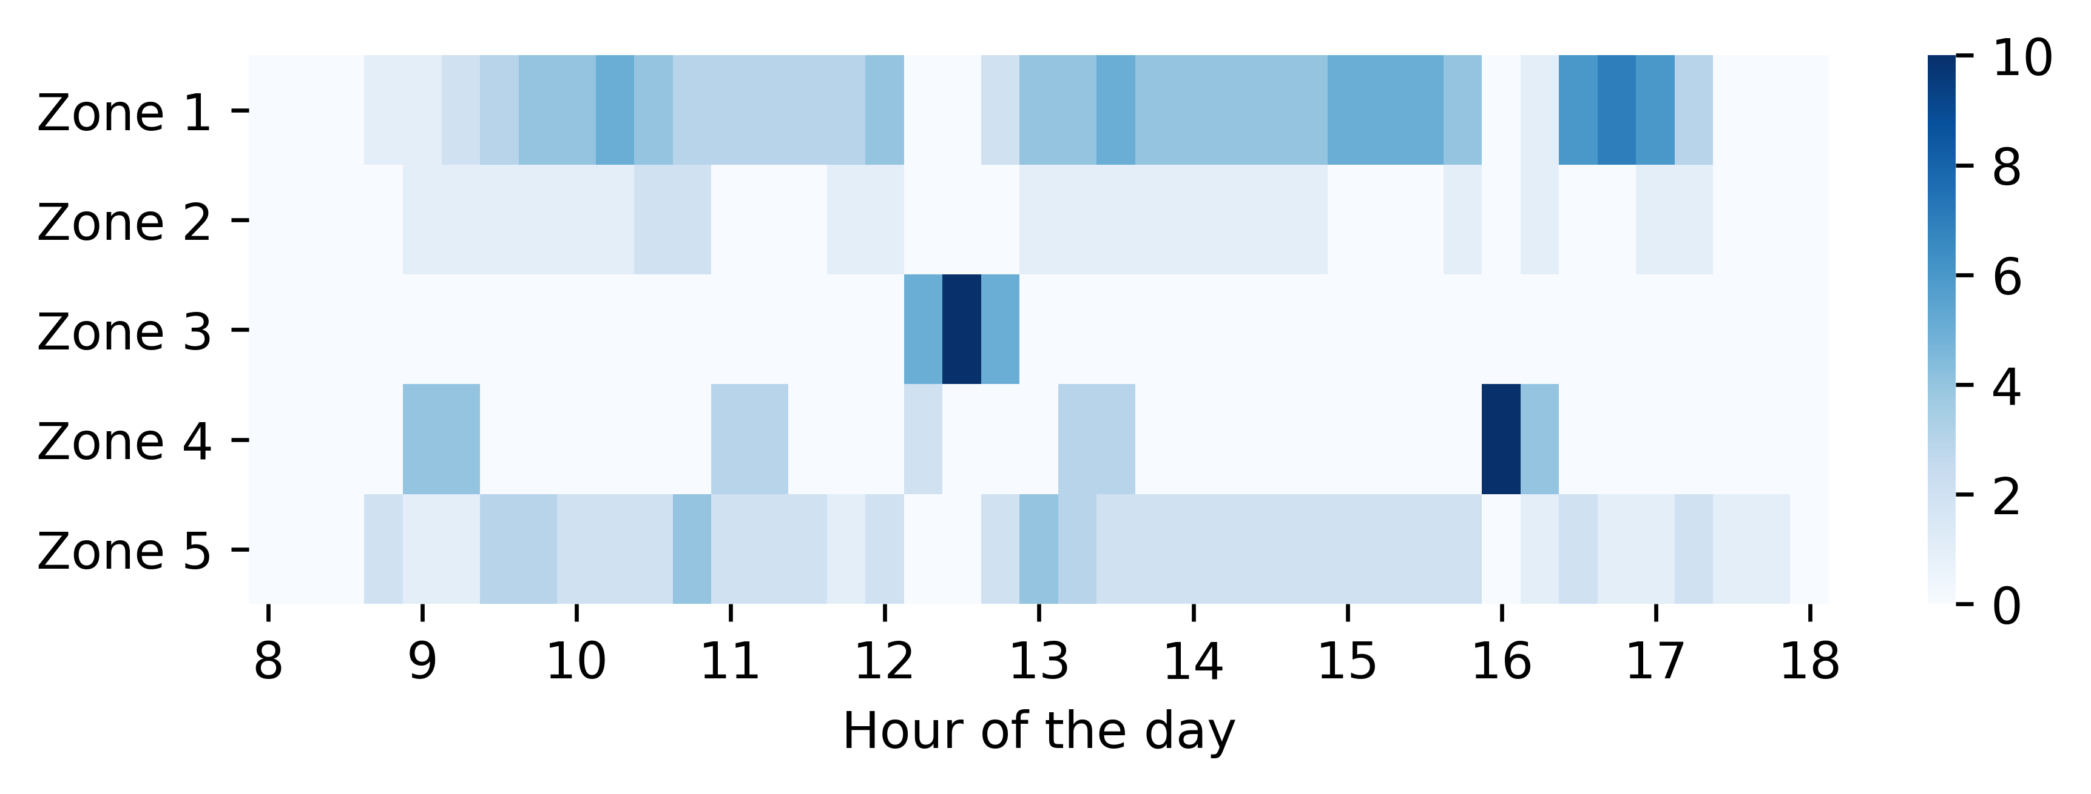
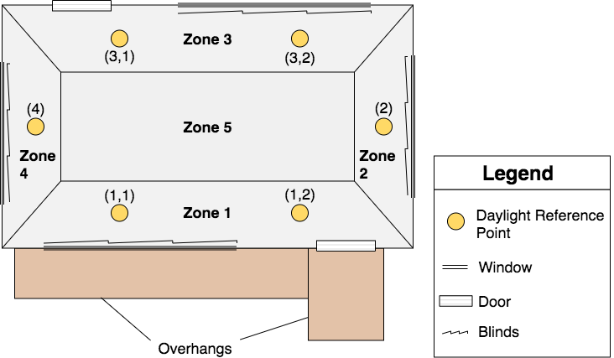
RL Problem Formulation
Zone-level occupancy
Building layout
Building-level occupancy
Notes:
The left figure shows the layout of the medium office building studied in this work, including the daylighting reference points. As we can see in this figure, we have 4 zone that contains a window, and for larger zone, zone 1 and zone 3, we used two daylighting reference points to calculate the indoor brightness. These reference points are located at desk height. Figures on the right shows the two-occupancy information we used in this study. Top on shows the zone-level occupancy schedules, and bottom shows the building-level occupancy. The building-level occupancy schedule assumes that all zones are occupied during the working hour. The zone-level occupancy schedule determines the number of occupants that are present in each zone at any given point in time.

Slide 11
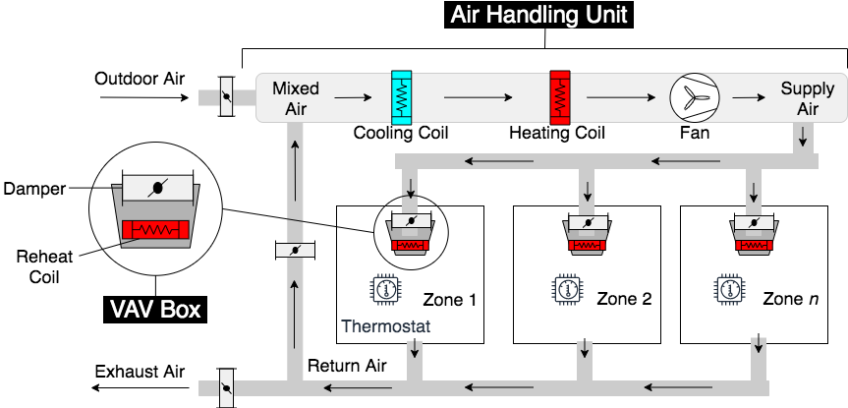
RL Problem Formulation
Notes:
This figure shows the design of the HVAC system. It consists of a centralized air handling unit (AHU) that moves conditioned air through the building via a duct system. In the AHU, the outside air and the return air from zones are mixed together. The mixed air is then heated or cooled using one heating coil and one cooling coil to a specified temperature before it is pushed through the duct system by a fan. Variable air volume (VAV) systems are used for controlling the amount of supply air by opening and closing a damper. A reheat coil present in the VAV box to heat the supply air in the zone to the desired temperature. This allows each zone to have its own thermostat with a unique temperature preference. These VAV setpoints are controlled using a feedback control strategy, and the VAV reheat coils are turned off in the cooling season.

Slide 12
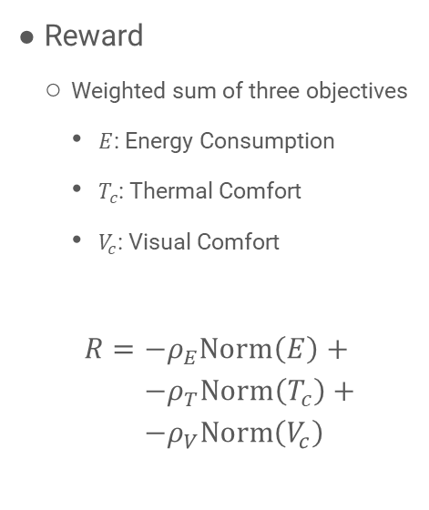
RL Problem Formulation
State
Temperature in each zone
Number of occupants in each zone
For building-level occupancy, set all zone to 1 in occupied period
Hour of the day
Angle for each blinds
Ambient temperature (with forecast)
Solar radiation (with forecast)
Action
Supply air temperature (SAT)
Angle for each blinds
Reward
Weighted sum of three objectives
$E$: Energy Consumption
$T_{c}$: Thermal Comfort
$V_{c}$: Visual Comfort
$$R=−ρ_{E}\text{Norm}\left(E\right)+ \\ −ρ_{T}\text{Norm}\left(T_{c}\right)+ \\ −ρ_{V}\text{Norm}\left(V_{c}\right)$$
Notes:
The state consists of the temperature in each zone, the number of occupants in each zone (for building-level occupancy schedule, all zones share the same value of 0 or 1, indicating whether the building is occupied), the hour of the day (0-24), the slat angle of the blinds (degrees) in each of the four zones that have windows, the ambient temperature, and the site solar radiation. In addition to these observations, it contains the weather forecast, which includes ambient temperature and site solar radiation for the next 3 hours. For this study, the forecast is assumed to be perfect.
The action is the SAT setpoint based on the mixed air temperature, and the angle for each blinds.
The reward is a weighted sum of three objectives, and the weight represent the relative importance of different objectives.

Slide 13
Control Scenarios
6 different control scenarios
HVAC | Blinds | Lighting
SAT setpoint | Always open | Not controlled
SAT setpoint | Always open | Auto Dimming
SAT setpoint | Using the same setpoint | Not controlled
SAT setpoint | Using the same setpoint | Auto Dimming
SAT setpoint | Using different setpoints | Not controlled
SAT setpoint | Using different setpoints | Auto Dimming
Notes:
First thing first, what is the motivation of doing this co-simulation platform? Previous research has shown that people spend around 87% of their time in buildings, and buildings account for 39% of total energy use in the US. Since people spend such a tremendous amount of time in buildings, it is crucial to maximizing the indoor environment's human comfort. While in the meantime, as the energy use of buildings is massive nowadays, reduce the total energy use of buildings is essential. These two points are hard to reach at the same time. Therefore, an optimal solution is to design an occupant-centric HVAC control system, which adjusts the HVAC controls based on the occupant actions and presence, in order to save energy and maintain the human comfort at the same time. But, we need data to explore such a control policy. Collecting data from real buildings and evaluating control algorithms on these buildings are costly and time-consuming. We shouldn't wait for a year to collect yearly data and test the algorithm for another year. For this reason, we need to run experiments in a simulated environment to collect data and evaluate control algorithms.

Slide 14
Baselines
4 baseline control scenarios
HVAC only
HVAC and blinds
HVAC with auto-dimming
HVAC and blinds with auto-dimming
HVAC setpoint is controlled by a reactive rule-based control policy that estimate the heating/cooling load to efficiently operate the HVAC system
Notes:
First thing first, what is the motivation of doing this co-simulation platform? Previous research has shown that people spend around 87% of their time in buildings, and buildings account for 39% of total energy use in the US. Since people spend such a tremendous amount of time in buildings, it is crucial to maximizing the indoor environment's human comfort. While in the meantime, as the energy use of buildings is massive nowadays, reduce the total energy use of buildings is essential. These two points are hard to reach at the same time. Therefore, an optimal solution is to design an occupant-centric HVAC control system, which adjusts the HVAC controls based on the occupant actions and presence, in order to save energy and maintain the human comfort at the same time. But, we need data to explore such a control policy. Collecting data from real buildings and evaluating control algorithms on these buildings are costly and time-consuming. We shouldn't wait for a year to collect yearly data and test the algorithm for another year. For this reason, we need to run experiments in a simulated environment to collect data and evaluate control algorithms.

Slide 15
Agents
Three model-free RL agents
Branching Dueling Q-Network (BDQN)
Soft Actor-Critic (SAC)
Proximal Policy Optimization (PPO)
Value-based
BDQN
Actor-Critic
SAC
Policy-based
PPO
Notes:
First thing first, what is the motivation of doing this co-simulation platform? Previous research has shown that people spend around 87% of their time in buildings, and buildings account for 39% of total energy use in the US. Since people spend such a tremendous amount of time in buildings, it is crucial to maximizing the indoor environment's human comfort. While in the meantime, as the energy use of buildings is massive nowadays, reduce the total energy use of buildings is essential. These two points are hard to reach at the same time. Therefore, an optimal solution is to design an occupant-centric HVAC control system, which adjusts the HVAC controls based on the occupant actions and presence, in order to save energy and maintain the human comfort at the same time. But, we need data to explore such a control policy. Collecting data from real buildings and evaluating control algorithms on these buildings are costly and time-consuming. We shouldn't wait for a year to collect yearly data and test the algorithm for another year. For this reason, we need to run experiments in a simulated environment to collect data and evaluate control algorithms.

Slide 16
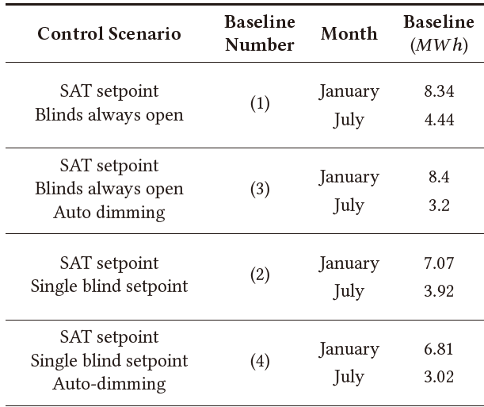
Research Questions and Results
How does the joint control of building systems affect the whole-building energy use?
Add blinds can save:
15.2% in Winter
11.7% in Summer
Add auto-dimming can save:
-0.1% in Winter
27.9% in Summer
Add both can save:
18.3% in Winter
32.0% in Summer
Notes:
First thing first, what is the motivation of doing this co-simulation platform? Previous research has shown that people spend around 87% of their time in buildings, and buildings account for 39% of total energy use in the US. Since people spend such a tremendous amount of time in buildings, it is crucial to maximizing the indoor environment's human comfort. While in the meantime, as the energy use of buildings is massive nowadays, reduce the total energy use of buildings is essential. These two points are hard to reach at the same time. Therefore, an optimal solution is to design an occupant-centric HVAC control system, which adjusts the HVAC controls based on the occupant actions and presence, in order to save energy and maintain the human comfort at the same time. But, we need data to explore such a control policy. Collecting data from real buildings and evaluating control algorithms on these buildings are costly and time-consuming. We shouldn't wait for a year to collect yearly data and test the algorithm for another year. For this reason, we need to run experiments in a simulated environment to collect data and evaluate control algorithms.

Slide 17
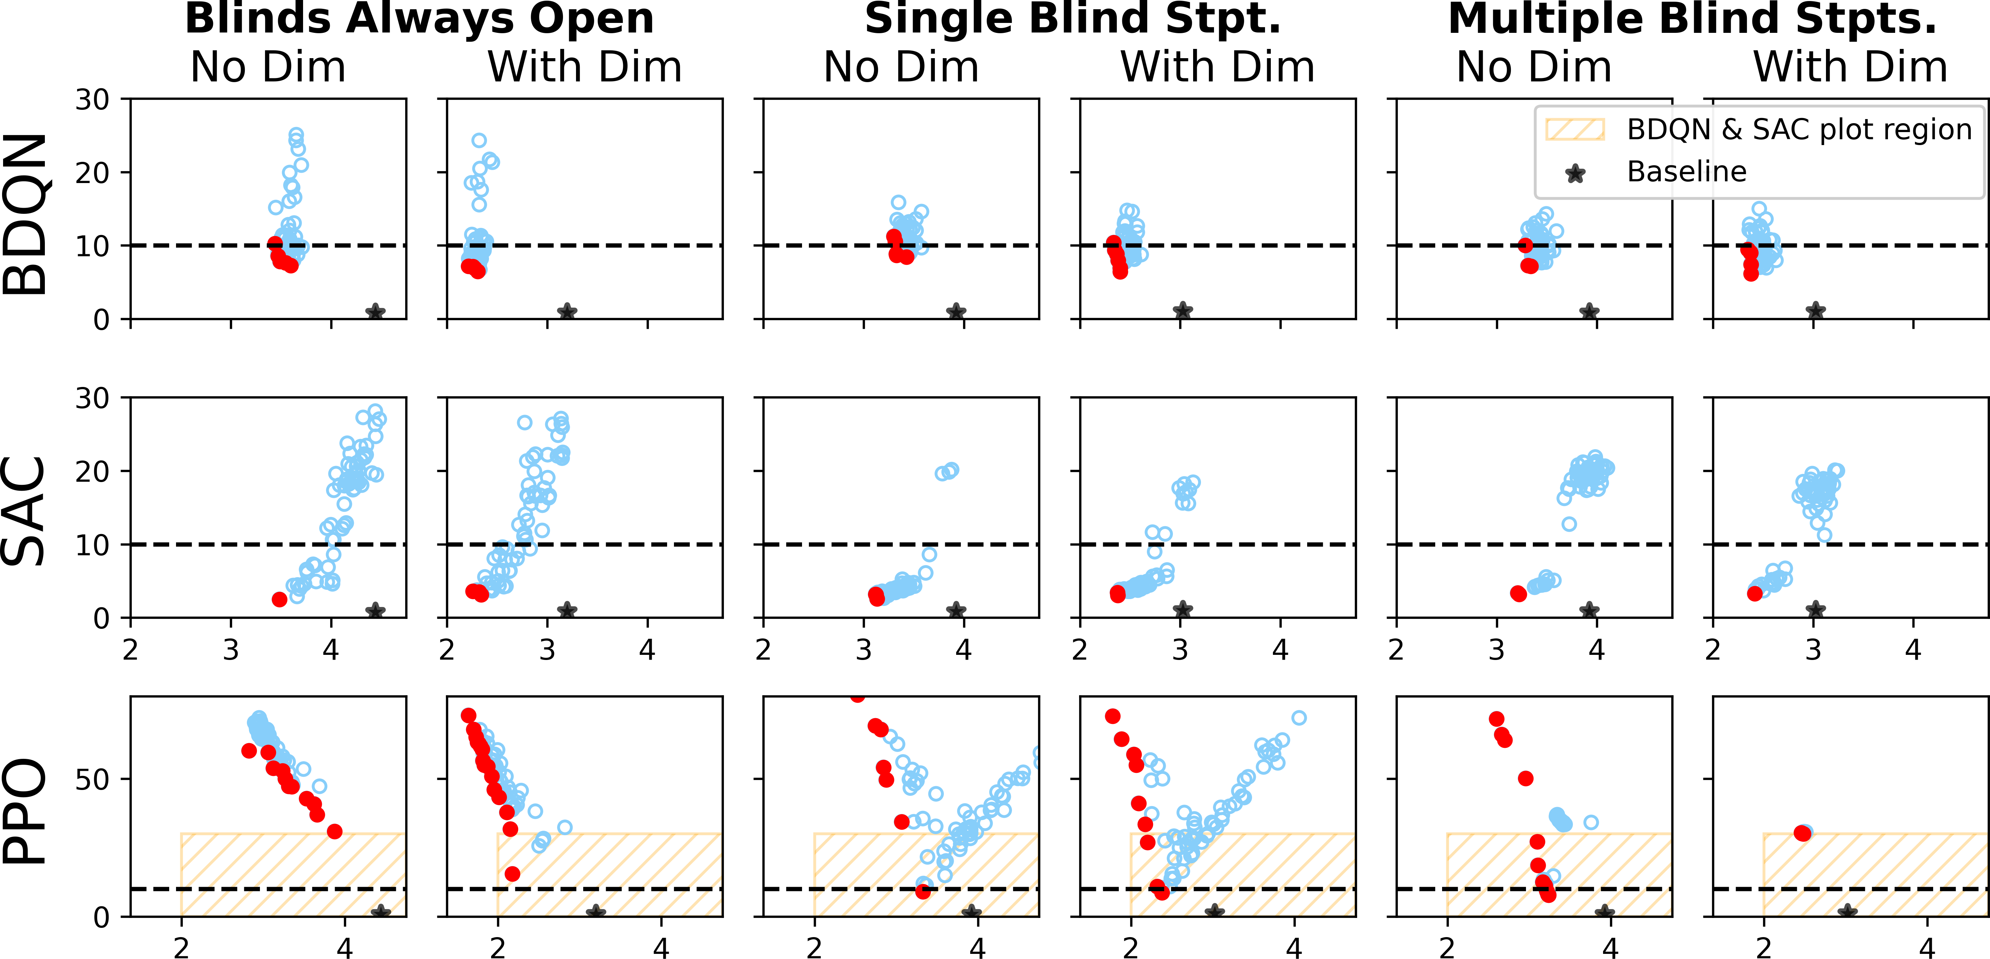
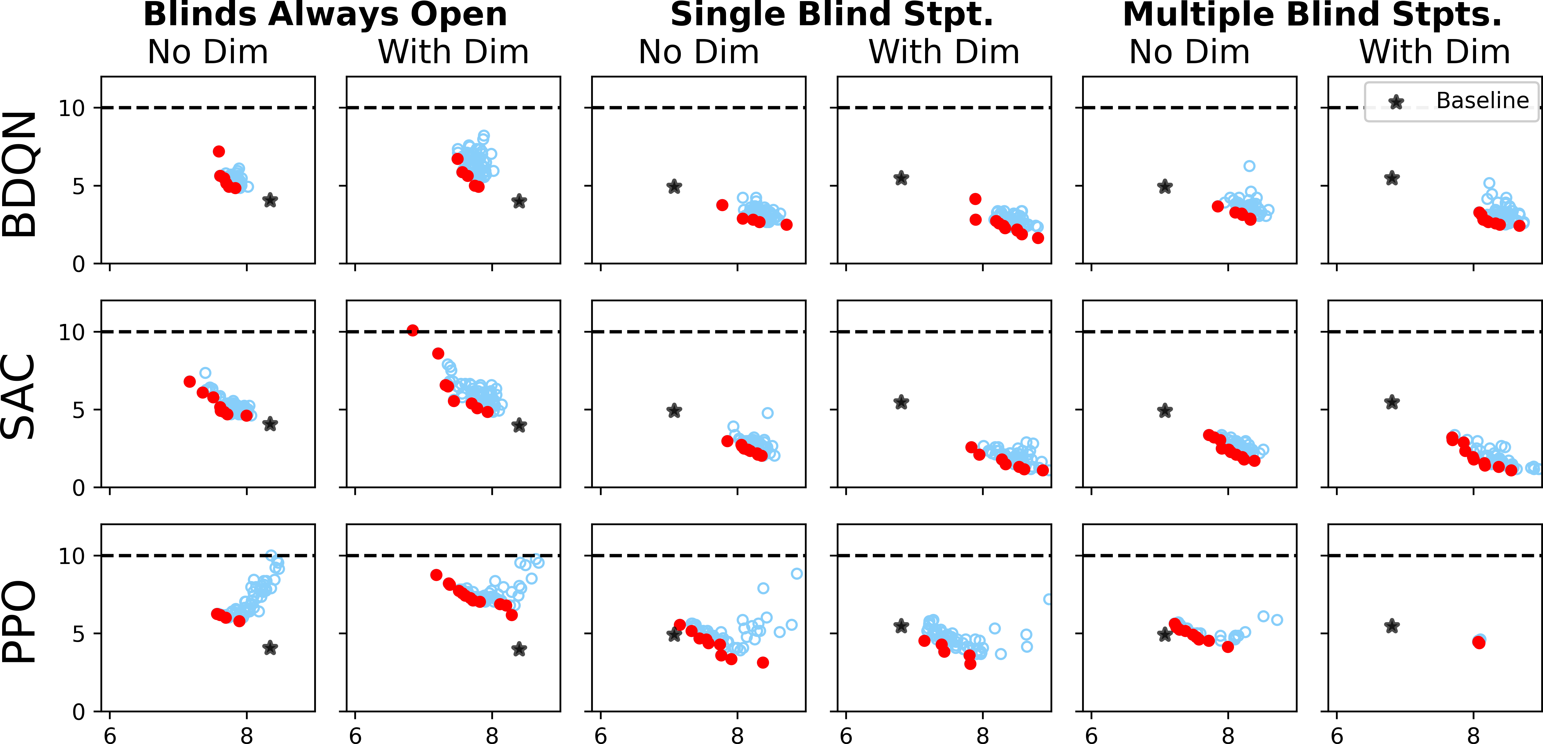
Research Questions and Results
What are the best trade-offs between energy use, thermal comfort, and visual comfort?
PPO is highly sensitive to the reward weights, whereas BDQN and SAC is less sensitive
(a) Cooling season with building-level occupancy schedule
(c) Heating season with building-level occupancy schedule
The PMV violation rate (y-axis) versus the monthly electricity consumption in MWh (x-axis) for different reward parameters.
Notes:
Points on the Pareto frontier are colored red and baselines are marked with black stars. The horizontal line shows ASHRAE’s threshold (10%) for thermal comfort violation

Slide 18
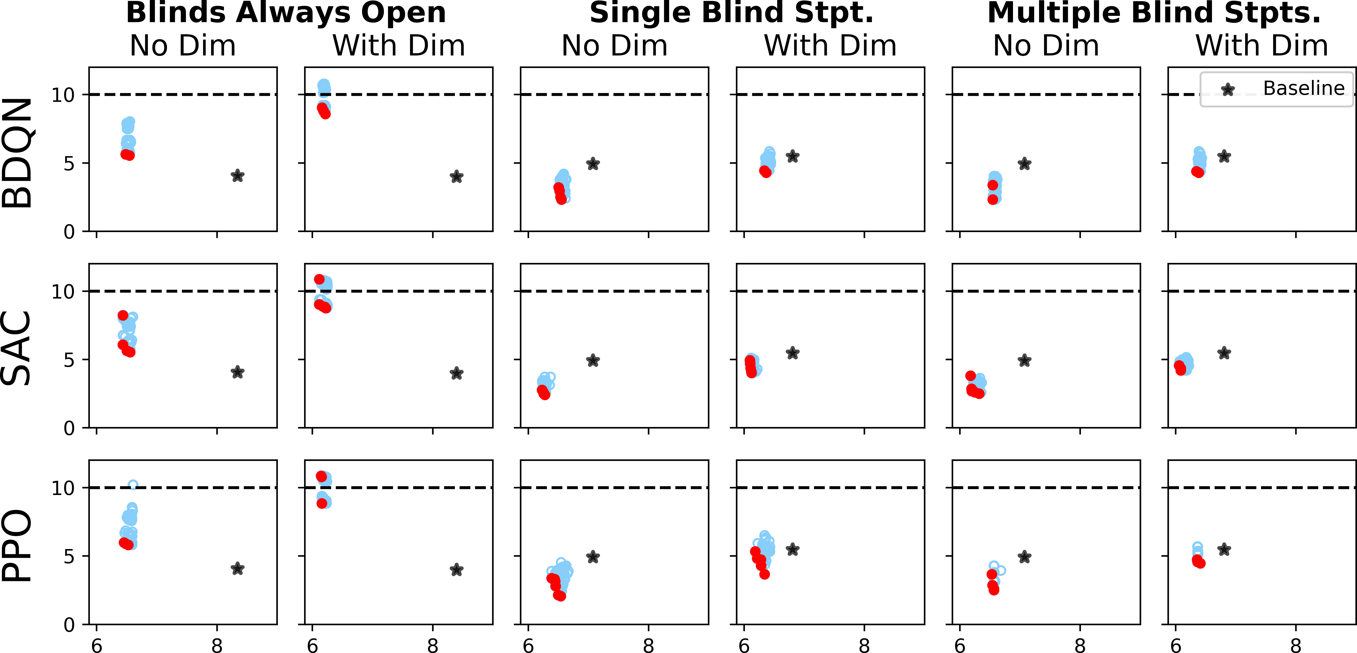
Research Questions and Results
Will incorporating zone-level occupancy information noticeably change the performance of a control policy?
Yes. Zone-level occupancy can provide annual energy savings of $437, or 6.24MWh.
(c) Heating season with building-level occupancy schedule
(d) Heating season with zone-level occupancy schedule
The PMV violation rate (y-axis) versus the monthly electricity consumption in MWh (x-axis) for different reward parameters.
Notes:
Figures c and d show the whole-building energy use in heating seasons along with the thermal comfort violation rate when the RL agents incorporate building-level occupancy information and the zone-level occupancy information. It can be readily seen that better trade-offs can be achieved in the heating season when the control agents incorporate zone-level occupancy information. Specifically, BDQN, SAC, and PPO agents can save respectively 3.3%, 18%, and 14% more energy when they take into account zone-level occupancy information rather than building-level occupancy information. The zone-level occupancy information allows the control agents to meet thermal and visual comfort requirements by conditioning only a subset of zones that are occupied. This reduces the energy consumption in HVAC and lighting systems.
Another important observation is that the RL agents cannot always beat the rule-based baselines when they rely on building-level occupancy information.

Slide 19
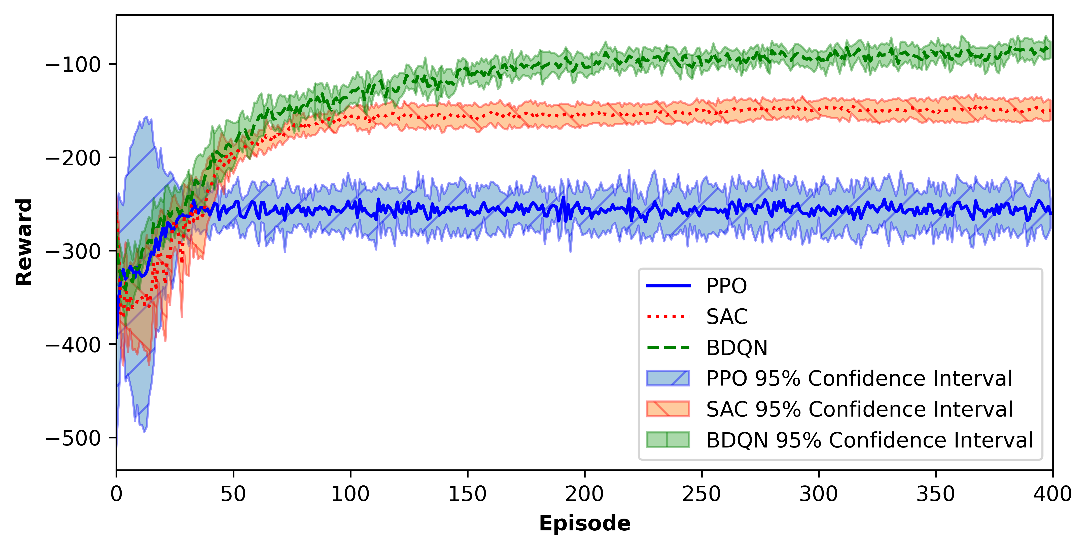
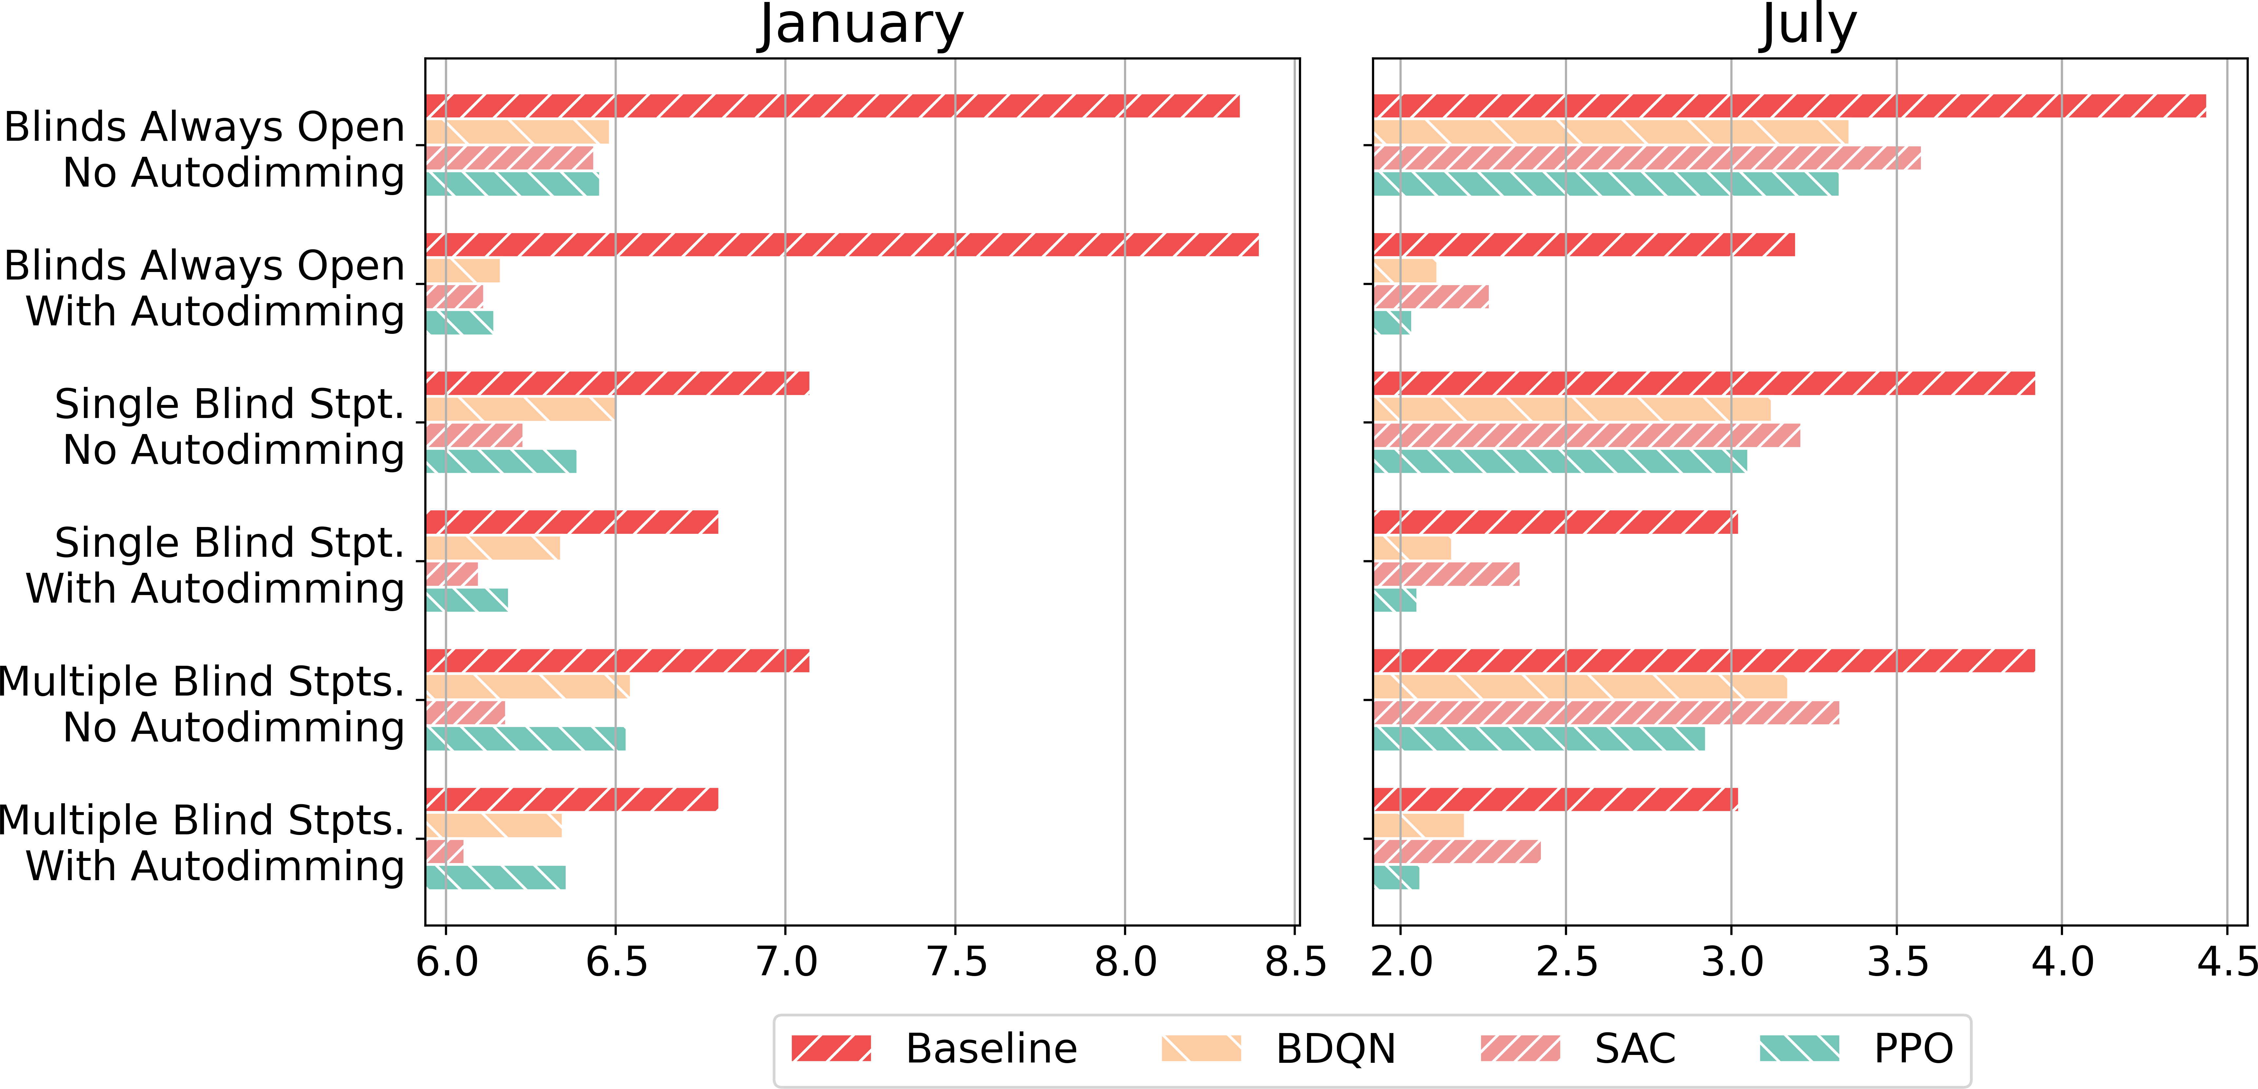
Research Questions and Results
Which RL algorithm works best?
Performance comparison of three RL algorithms
on the building control domain
Energy consumption of different RL agents using a zone-level occupancy schedule
Notes:
Figure 6 illustrates the total reward accumulated in each episode when RL agents control the SAT setpoint and 4 blind setpoints, and lights are auto-dimmed. The episode reward is averaged across 10 runs with different random seeds. The shaded region around the average episode reward depicts the 95% confidence interval. From this figure it is evident that BDQN converges to the highest reward, followed by SAC. Looking at the convergence speed, PPO, SAC, and BDQN agents converge at around 30, 100, and 200 episodes, respectively. SAC and BDQN agents show more stable performance (narrower confidence interval) compared to the PPO agent. They have better sample complexity and can effectively use experiences from previous episodes to update the policy. Unfortunately this means that their running time is higher than PPO and they use more memory. In particular, SAC and BDQN agents finish a run in 38 and 31 hours respectively on a server with Intel Xeon E5-2650 v4 (2.2GHz CPU) and NVIDIA Tesla P100 GPUs, and need around 8GB of memory. For PPO, on the other hand, it takes only 7 hours to run on the same server using 4GB of memory. While Figure 6 only shows the average reward per episode in the cooling season with zone-level occupancy information and a specific reward parameter setting (𝜌𝐸 = 1, 𝜌𝑇 = 1 and 𝜌𝑉 = 0.4), we witnessed similar convergence behavior for other reward parameter settings, months, and occupancy schedules.
We show here that SAC outperforms BDQN in the heating season (in all scenarios except one) with regard to energy savings. Considering thermal comfort, PPO is not able to satisfy the thermal comfort in the cooling season for most cases with average thermal comfort violation rate of 10.8%; SAC exceeds the threshold once and BDQN can always maintain the thermal violation rate under the threshold. Turning our attention to the effort needed to tune reward parameters, PPO is highly sensitive to these parameters, whereas BDQN and SAC are less sensitive to the reward parameters. Also, PPO converges remarkably faster than SAC, and SAC is slightly faster than BDQN. As the requirements might differ from case to case, there is no clear winner among these three RL agents. SAC and BDQN seem to offer more promising results if one can afford the one-time computation cost of training the agents.

Slide 20
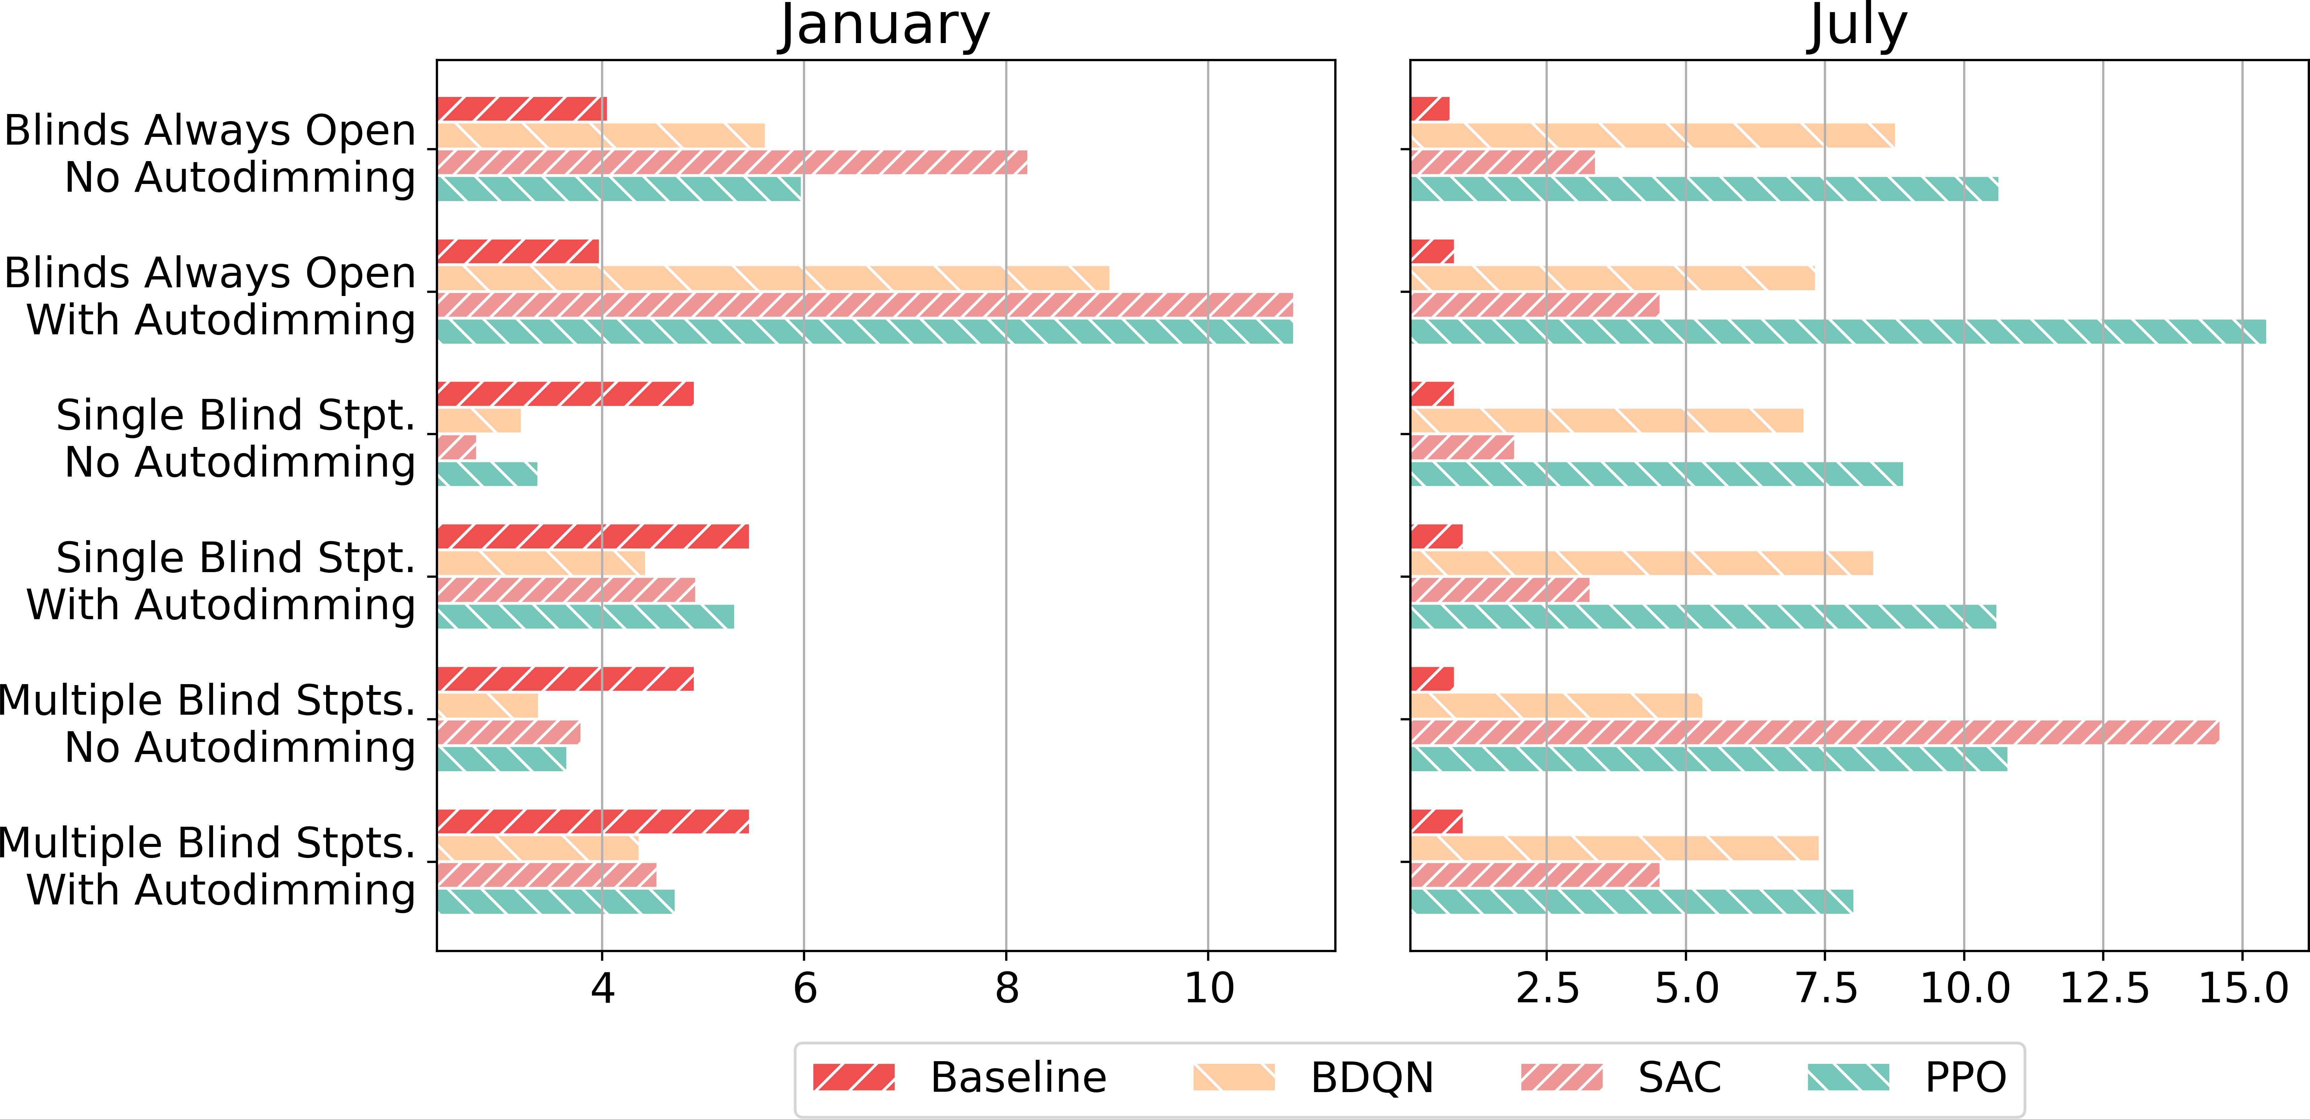
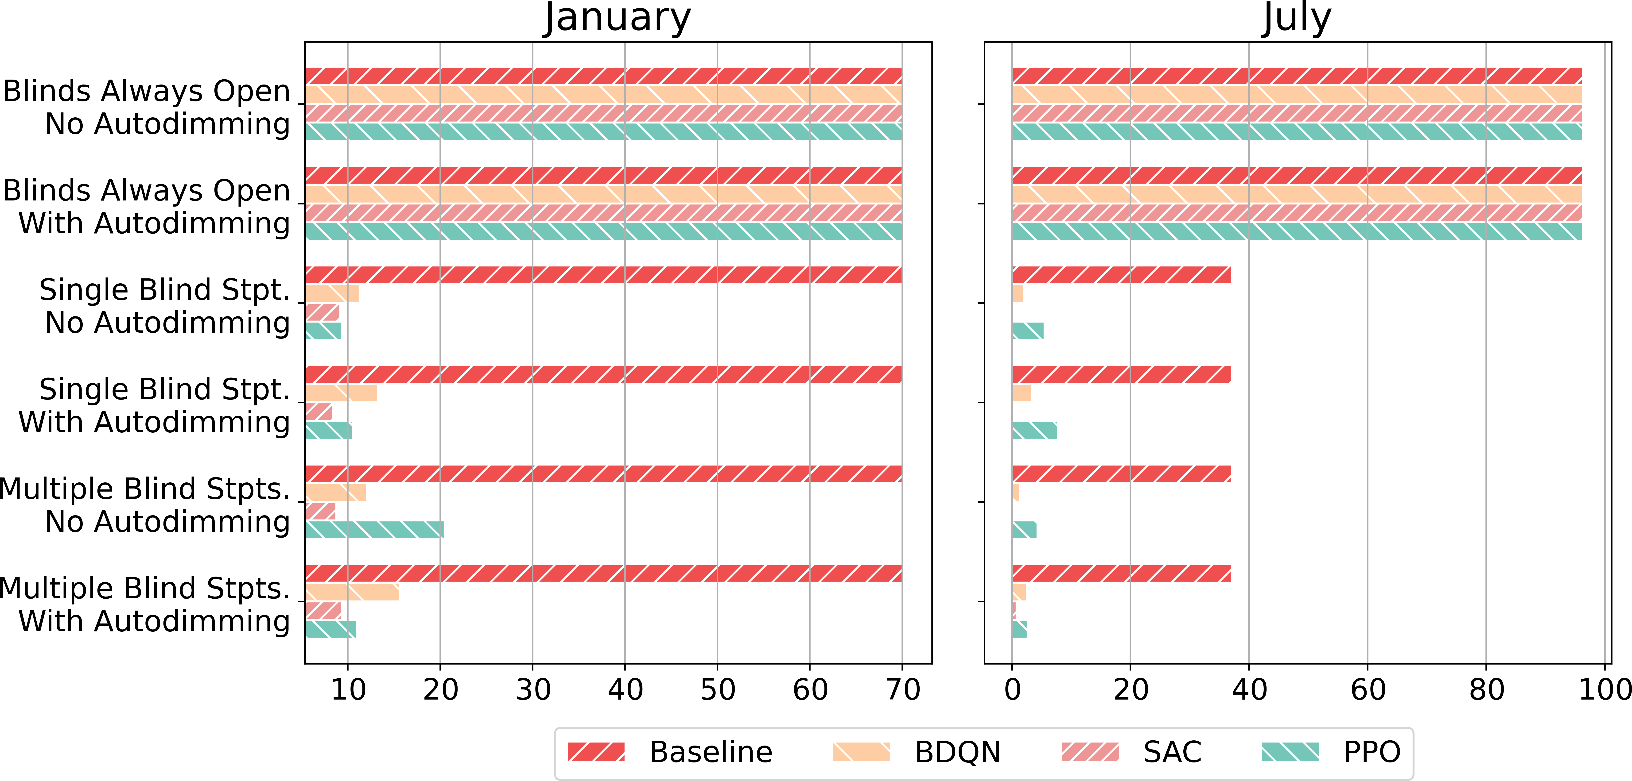
Research Questions and Results
Which RL algorithm works best?
Thermal comfort violation rate of different RL agents using a zone-level occupancy schedule
Visual comfort violation rate of different RL agents using a zone-level occupancy schedule
Notes:
Figure 6 illustrates the total reward accumulated in each episode when RL agents control the SAT setpoint and 4 blind setpoints, and lights are auto-dimmed. The episode reward is averaged across 10 runs with different random seeds. The shaded region around the average episode reward depicts the 95% confidence interval. From this figure it is evident that BDQN converges to the highest reward, followed by SAC. Looking at the convergence speed, PPO, SAC, and BDQN agents converge at around 30, 100, and 200 episodes, respectively. SAC and BDQN agents show more stable performance (narrower confidence interval) compared to the PPO agent. They have better sample complexity and can effectively use experiences from previous episodes to update the policy. Unfortunately this means that their running time is higher than PPO and they use more memory. In particular, SAC and BDQN agents finish a run in 38 and 31 hours respectively on a server with Intel Xeon E5-2650 v4 (2.2GHz CPU) and NVIDIA Tesla P100 GPUs, and need around 8GB of memory. For PPO, on the other hand, it takes only 7 hours to run on the same server using 4GB of memory. While Figure 6 only shows the average reward per episode in the cooling season with zone-level occupancy information and a specific reward parameter setting (𝜌𝐸 = 1, 𝜌𝑇 = 1 and 𝜌𝑉 = 0.4), we witnessed similar convergence behavior for other reward parameter settings, months, and occupancy schedules.
We show here that SAC outperforms BDQN in the heating season (in all scenarios except one) with regard to energy savings. Considering thermal comfort, PPO is not able to satisfy the thermal comfort in the cooling season for most cases with average thermal comfort violation rate of 10.8%; SAC exceeds the threshold once and BDQN can always maintain the thermal violation rate under the threshold. Turning our attention to the effort needed to tune reward parameters, PPO is highly sensitive to these parameters, whereas BDQN and SAC are less sensitive to the reward parameters. Also, PPO converges remarkably faster than SAC, and SAC is slightly faster than BDQN. As the requirements might differ from case to case, there is no clear winner among these three RL agents. SAC and BDQN seem to offer more promising results if one can afford the one-time computation cost of training the agents.

Slide 21
Takeaways
Joint control can reduce total energy consumption
Fine-grained occupancy information can benefit model-free RL agents
Model-free RL agents can always outperform baselines if zone-level occupancy is available
Only PPO is sensitive to the reward parameters
Notes:
First thing first, what is the motivation of doing this co-simulation platform? Previous research has shown that people spend around 87% of their time in buildings, and buildings account for 39% of total energy use in the US. Since people spend such a tremendous amount of time in buildings, it is crucial to maximizing the indoor environment's human comfort. While in the meantime, as the energy use of buildings is massive nowadays, reduce the total energy use of buildings is essential. These two points are hard to reach at the same time. Therefore, an optimal solution is to design an occupant-centric HVAC control system, which adjusts the HVAC controls based on the occupant actions and presence, in order to save energy and maintain the human comfort at the same time. But, we need data to explore such a control policy. Collecting data from real buildings and evaluating control algorithms on these buildings are costly and time-consuming. We shouldn't wait for a year to collect yearly data and test the algorithm for another year. For this reason, we need to run experiments in a simulated environment to collect data and evaluate control algorithms.

Slide 22
Future Works
Control more components of building systems
Explore the performance of agents in a more complex building
Notes:
First thing first, what is the motivation of doing this co-simulation platform? Previous research has shown that people spend around 87% of their time in buildings, and buildings account for 39% of total energy use in the US. Since people spend such a tremendous amount of time in buildings, it is crucial to maximizing the indoor environment's human comfort. While in the meantime, as the energy use of buildings is massive nowadays, reduce the total energy use of buildings is essential. These two points are hard to reach at the same time. Therefore, an optimal solution is to design an occupant-centric HVAC control system, which adjusts the HVAC controls based on the occupant actions and presence, in order to save energy and maintain the human comfort at the same time. But, we need data to explore such a control policy. Collecting data from real buildings and evaluating control algorithms on these buildings are costly and time-consuming. We shouldn't wait for a year to collect yearly data and test the algorithm for another year. For this reason, we need to run experiments in a simulated environment to collect data and evaluate control algorithms.

